Slide 1

A New Model to Capture the Impact of Behaviours on the Spread of Infectious Diseases
Department of Industrial Engineering
Riccardo Tessarin - 222819
Supervisor: Co-Supervisor: Prof. Giulia Giordano Dr. Daniele Proverbio
Final examination date: December 12, 2024
Notes:
Hi everyone, and welcome to my thesis presentation, which is about a newly developed model that aims to capture the impact of behavior on epidemic spread.
I will briefly introduce the topic and the main objectives of the thesis, I present the developed model, how it is designed and its main characteristics. Then, the results of the simulations, the analysis performed, and how it is computed the basic reproduction number of the whole model is shown. And I will conclude with some final remarks and take-home messages.

Slide 2
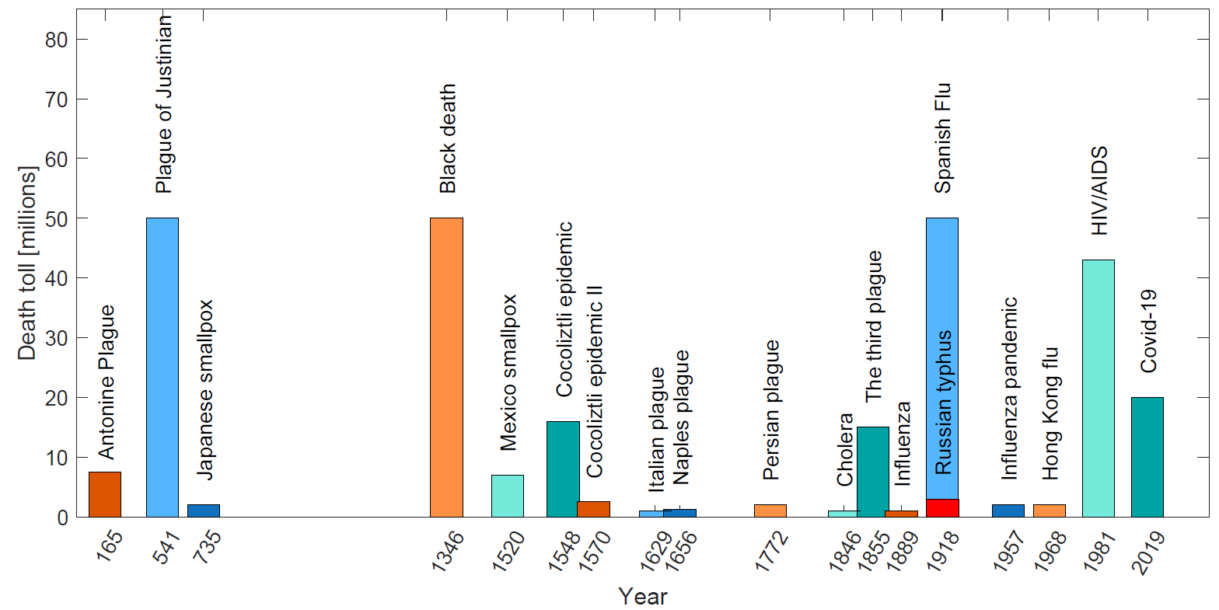
Why studying Epidemiology
01
Notes:
So, why study epidemiology?
The answer mainly relies on the fact that in all human history there were epidemics. They had great effects on humanity, both in terms of human lives and by altering social dynamics. And these two effects are mutually dependent. Disease may cause social unrest, and alter our life, while behavior, can influence disease evolution both positively (if use of precautions habits diffuse for example), or negative if there is a fake-news regarding false scientific information. Also, every year new disease develop, and this maintain high the interest in such topic.

Slide 3
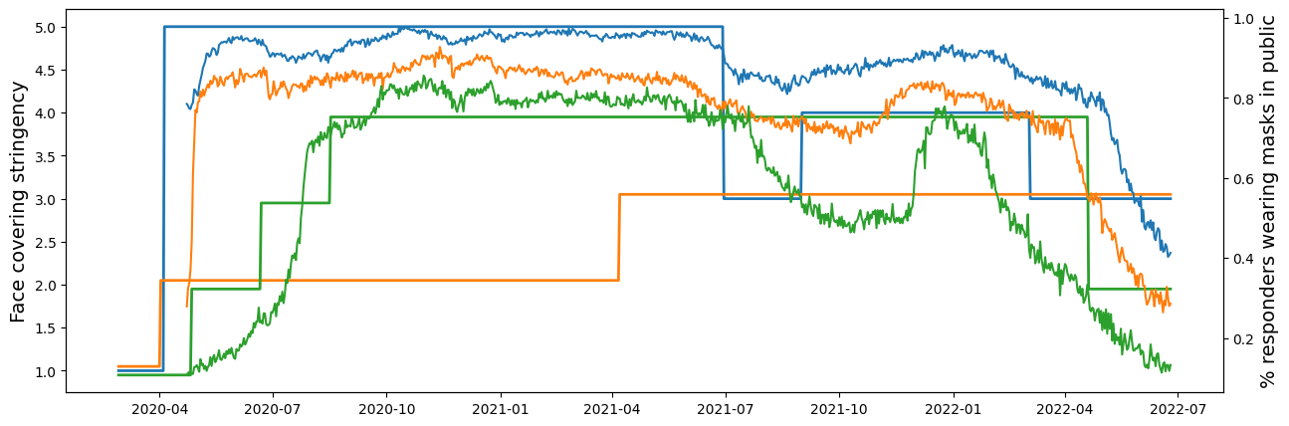
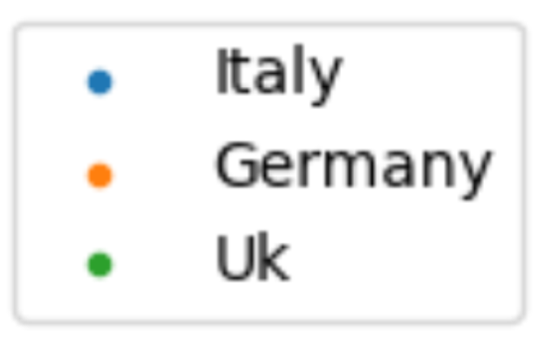
01
Motivations: SAHCIR model
Inspire model choice
Safe behaviors
Epi- behavioral model
Epi-behavioral data
Simulate empirical trends
Example: Empirical data of mask wearing in different countries during COVID-19. Figure from Proverbio et al. .
Notes:
The epidemiological model realized for the thesis wants to investigate such relationship, and it is developed by taking concepts from theoretical frameworks , but also and mainly by empirical data observations, regarding compliancy within the use of precautions during an epidemic. The recent COVID-19 provided extensive data on population behavior during an epidemic. This type of information was historically difficult to obtain and represent a major novelty that has not already been used. Data reproducing real behavior is an important source of information: for instance, consider the figure showing mask-wearing trends in three different countries. The behavioral trends, especially in the first epidemic phase, follow closely the evolution of stringency.
The choice of realize a new model is then done to develop a model that can reproduce scenarios like this, and give insights within an analytically tractable framework.

Slide 4
Objectives
02
I. Realize the coupling of three phenomena: - P2P mechanism - “fatigue” - policy effect
II. Analyse stability, simulate evolutions and study Threshold effect of the proposed model.
Notes:
In particular, the main objectives that want to be achieved are:
Includig in the model mechanisms as:
Person-to-person contact mechanisms for both disease transmission and behavioral influence.
Fatigue effects related to maintaining certain behaviors.
The potential impact of government policies on people's behavior.
Study the model both analytically and with simulations, and derive its reproduction number.

Slide 5
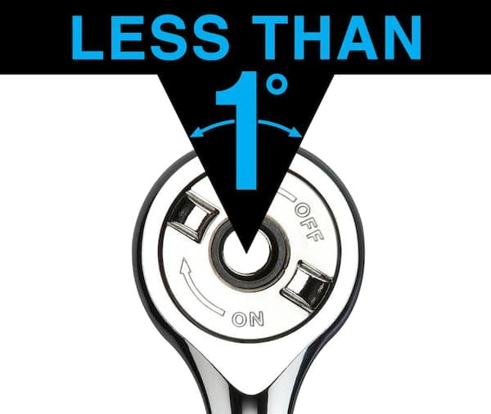
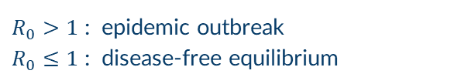
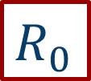
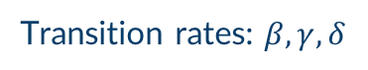

Mean field models
03
Homogeneous mixing
Population conservation
$$S+I+R=1$$
Transition rates: $β, γ, δ$
$$R_{0}$$
Basic reproduction number
Treshold value
$R_{0}>1$ : epidemic outbreak
$R_{0}≤1$ : disease-free equilibrium
Notes:
The method used for design the model is based on the mean-field approximation. That instead of tracking the disease state of single agents in a whole population, implements a set of compartments, reproducing different possible state, and uses differential equation to describe the evolution of each of this compartments. The individuals in a compartment have the same probability of being in contact with individuals in others compartments, and this is called homogeneous mixing assumption. Another common assumption in this class of models is population conservation. This means the total population remains constant, expressed mathematically as S+I+R=1, where the population has been normalized.
The transition rates between compartments are:
Beta (β): The transmission rate.
Gamma (γ): The recovery rate.
Delta (δ): The immunity waning rate.
An important concept connected to mean-field models is the basic reproduction number (R0). This represents the average number of secondary infections caused by a single infected person in a fully susceptible population. The most significant result linked to R_0 is the "threshold effect":
If R0>1: An epidemic will spread through the susceptible population.
If R0 < 1: The disease will die out.

Slide 6
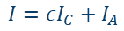
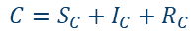

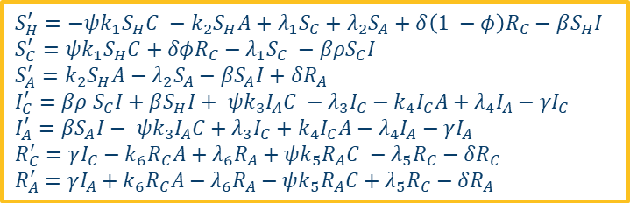
04
SAHCIR model
$$S_{H}^{′}=−ψk_{1}S_{H}C −k_{2}S_{H}A+λ_{1}S_{C}+λ_{2}S_{A}+δ\left(1 −φ\right)R_{C}−βS_{H}I$$
$$S_{C}^{′}=ψk_{1}S_{H}C+δφR_{C}−λ_{1}S_{C} −βρS_{C}I$$
$$S_{A}^{′}=k_{2}S_{H}A−λ_{2}S_{A}−βS_{A}I+δR_{A}$$
$$I_{C}^{′}=βρ S_{C}I+βS_{H}I+ ψk_{3}I_{A}C −λ_{3}I_{C}−k_{4}I_{C}A+λ_{4}I_{A}−γI_{C}$$
$$I_{A}^{′}=βS_{A}I− ψk_{3}I_{A}C+λ_{3}I_{C}+k_{4}I_{C}A−λ_{4}I_{A}−γI_{A}$$
$$R_{C}^{′}=γI_{C}−k_{6}R_{C}A+λ_{6}R_{A}+ψk_{5}R_{A}C −λ_{5}R_{C}−δR_{C}$$
$$R_{A}^{′}=γI_{A}+k_{6}R_{C}A−λ_{6}R_{A}−ψk_{5}R_{A}C+λ_{5}R_{C}−δR_{A}$$
$$A=S_{A}+I_{A}+R_{A}$$
$$C=S_{C}+I_{C}+R_{C}$$
$$I=εI_{C}+I_{A}$$
Notes:
Now, I can show you the model developed in the thesis. As visible it is composed by seven different compartments and it is the result of the coupling of a SIRS epidemic model, and a behavioral model, in which the population can be split in 3 different groups:
Heedless group: People careless about the risk associated with the infection, where it is supposed most of the population is when a new disease appears.
Compliant group: Individuals that are actively trying to avoid becoming infected or infecting others.
Against group: Individuals skeptical about the infection risk, who disbelieve or resist preventive measures.
From the figure of the model we can see, how the disease develop in the vertical direction, and the behavioral dynamic on the horizontal one.
The behavior change rates is ruled by persuasion rates k. The fatigue to maint a certain behavior is described by fatigue rate \lambda. The model developed accounts for effects such as:
Protection to becoming infectious, ruled by \rho parameter, reflecting compliance with safety precuations.
Self-isolation while Infectious, a parameter representing the non- participation of compliant individuals in the infection process, \epsilon
A parameter used to describe the effect of policy stringencies in increasing Compliancy \psi
In the susceptible layer, all behavioral states are represented. However, in the infected and recovered compartments, it is assumed that the heedless behavior is not relevant, as infected or previously infected individuals are aware of the disease's existence.

Slide 7

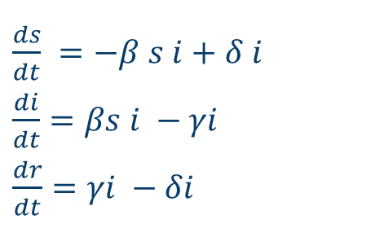
04
SIRS model
epidemic layer
Example: $R_{0}=$ 3.273 > 1
There is an epidemic outbreak!
$\frac{ds}{dt}$ $=−β s i+δ i$
$\frac{di}{dt}=βs i −γi$
$\frac{dr}{dt}=γi −δi$
Notes:
If now, we consider that the behavioral compartments are lumped, the resulting epidemic model is a normal SIRS. Its system of equations is shown here, with differential equations describing model evolution, corresponding to the flow between compartments, Susceptible, Infectious and Recovered
Using conditions similar to the early phase of the COVID-19 pandemic, the corresponding basic reproduction number was calculated as an example. It is greater than 1, so it expected an epidemic outbreak, and the simulation visible in figure confirms that. We see a sharp peak of infections compartment, followed by a decline. However, due to waning immunity, the infected compartment does not reach zero, leaving the disease endemic in the population. ! Similar simulations and analysis can be performed also for the behavioral model alone, to understand its characteristics.

Slide 8
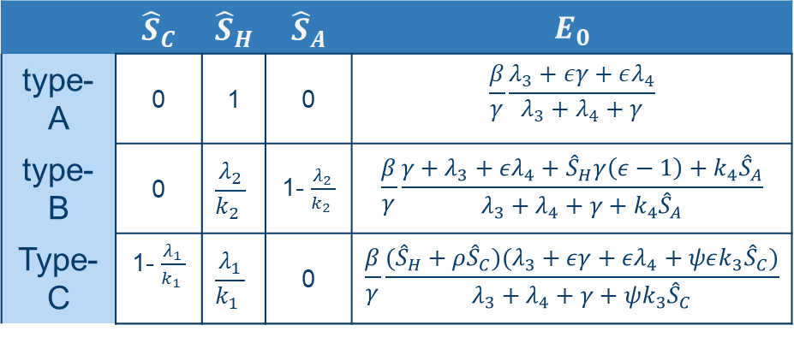
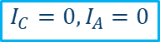
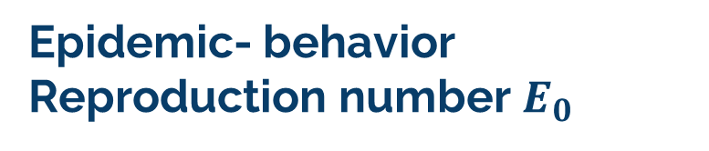
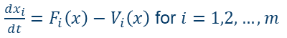
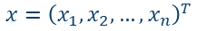
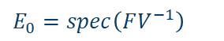
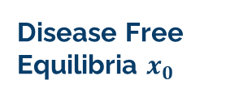
Epidemic- behavior Reproduction number $E_{0}$
Next generation matrix method
Disease Free Equilibria $x_{0}$
05
$$x={\left(x_{1},x_{2},…, x_{n}\right)}^{T}$$
$$E_{0}=spec\left(FV^{−1}\right)$$
$\frac{dx_{i}}{dt}=F_{i}\left(x\right)−V_{i}\left(x\right)$ for $i=1,2,…, m$
$$I_{C}=0, I_{A}=0$$
Notes:
A first operation done to study the multi-system model and realize an instrument that can be used to understand for which situations, there can be an epidemic outbreak, is the derivation of the Epidemic reproduction number, using the next generation matrix method. This method defines that the Reproduction number of an epidemic is equal to the spectral radius od the matrix resulting by the invers of the matrix multiplication of F, and V. In F there are all terms linked to the input of new infection in the Infected compartments, while in V there are the outer influxes and outfluxes in the Infected compartment. The F and V matrices for the model are computed, and then to evaluate the epidemic reproduction number, the disease-free equilibria of the system must be computed. Three possible equilibria are found, as visible in the table, and the corresponding E_0 value is found.

Slide 9
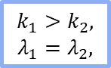

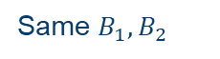
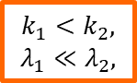
Simulations with different $E_{0}$
05
$$k_{1}>k_{2},$$
$$λ_{1}=λ_{2},$$
$$k_{1}<k_{2},$$
$$λ_{1}≪λ_{2},$$
Same $B_{1},B_{2}$
Different DFE
Notes:
A first results of model evolution is here visible, in this case we have k1 > k2, and equal lambda values. A quantity called the "Behavior Conversion Number" is defined as the ratio between persuasion and fatigue rates is used to understand what behavior is stronger, and asymptotically dominant. The compliant behavior in this case has a larger behavior conversion number, equal to 7, than the against one, which is equal to 3. The resulting E0 is equal to 1.11, so there is a substantial decrease with respect to the pure epidemic R0, seen before that is equal to 3.27. We observe that most of the population becomes SC, and there is a very small infection peak.
Instead in the second situations, k1 < k2 and lambda1 < lambda2 even if the behavior conversion number has the same value. So, the Compliant has still the higher behavior conversion number, but Against behavior is more persuasive, even if is very less enduring. Also, the disease-free equilibrium from which the system starts is different, with the majority of the population in the SA group. We observe that initially the SA seems to remain stable, there is a high infection peak, but then the Compliant behavior become more and more diffuses and this contribute to stop the infection.

Slide 10
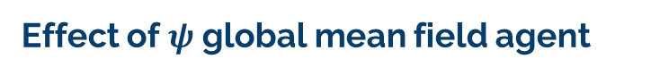
Effect of $ψ$ global mean field agent
05
Notes:
A last notable result is connected to the effect of the psi parameter, which is the one that simulates the effect of policy stringency. Clearly if \psi >1 there is a rapid shift of the SC curve to higher value, and in the infected curve we can observe a huge decrease in the peak value.

Slide 11
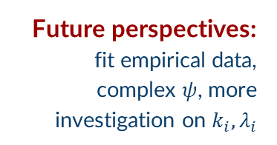
01
02
03
04
06
Conclusion
Thanks!
Behavior-Epidemic interactions
Insights from analysis and simulations
SAHCIR MODEL
Possible limitations
Future perspectives: fit empirical data, complex $ψ$, more investigation on $k_{i}, λ_{i}$
Homogeneous mixing, H only in S
Notes:
In conclusion, the model highlights the interplay between disease and behavior. It demonstrates the importance of considering behavioral factors in epidemic modeling, as they can significantly alter the course of an epidemic. Furthermore, the found E_0 epidemic reproduction number can reproduce epidemic insurgence. The framework considered with the model is promising and can be easily adapted to reproduce very different scenarios, for example both the spread of fake news in an initial epidemic phase, and the fatigue associated with the compliancy when rules are implemented for a long time. A limitations of the model, is the homogenous mixing assumption, that can be a limitation in term of realism, while a possible improvement can be tje insertion of the H compartment also in the I and R layer, to represent a group that has no interest in convince other,. Possible future perspective are the realization of parameters ruling the model fitting with real data, and development of more detailed study on psi functional shape, and further investigations of the ki and lambda_i relations.
THANKS FOR YOUR ATTENTION!

Slide 12
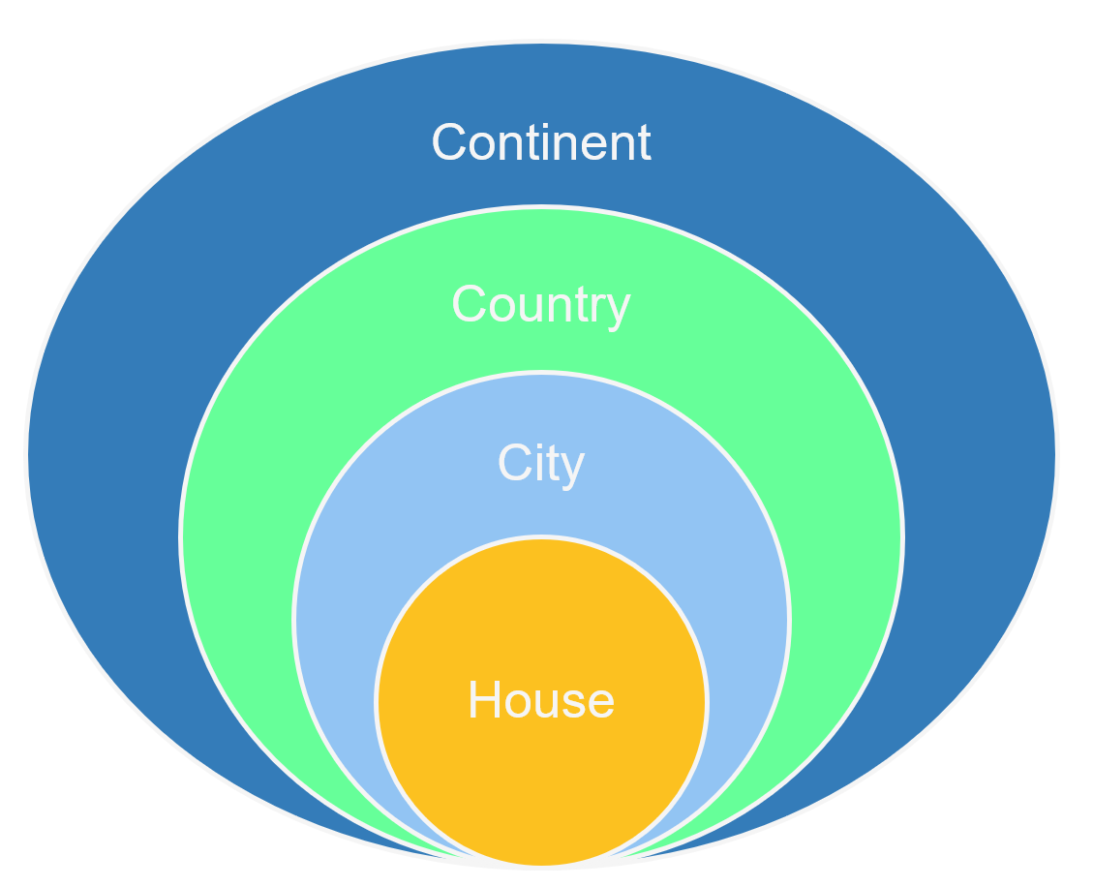

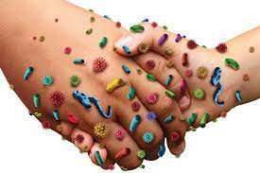
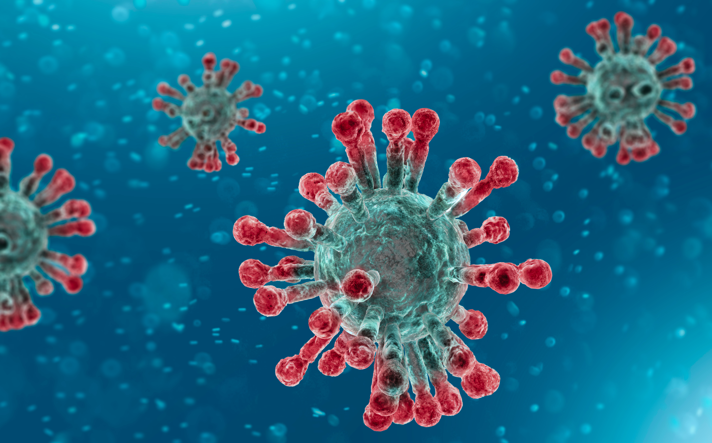
Introduction
Epidemic spreading: multiple layers and scales are involved
Model people behavior during an epidemic
Population interconnections
Population interactions
Microscopic, infection dynamic within a host

Slide 13
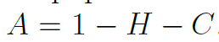
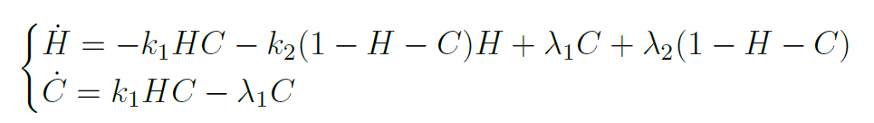
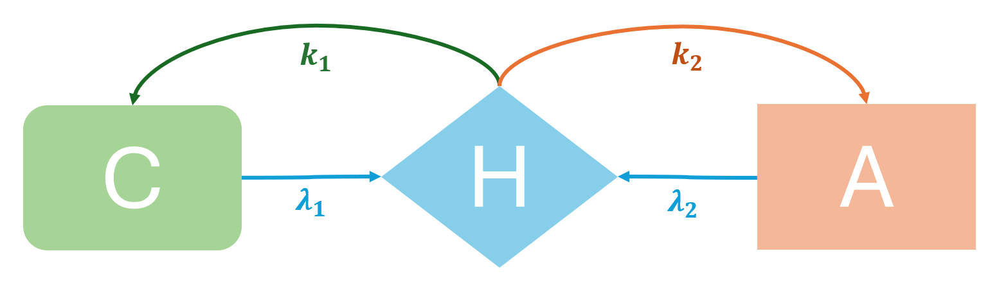
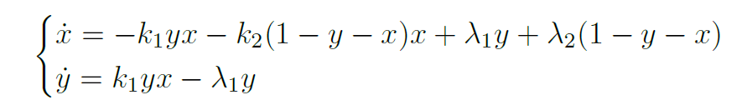
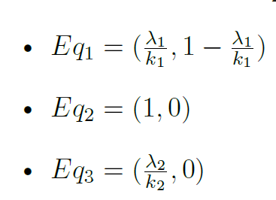
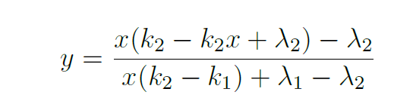
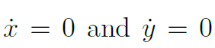
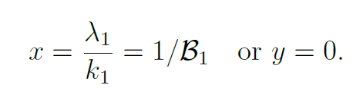
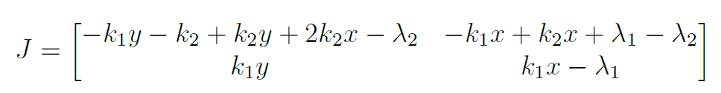
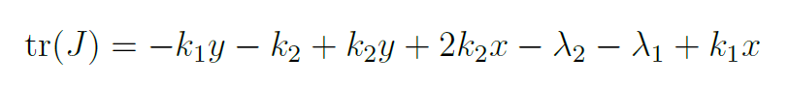
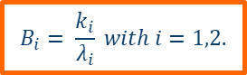
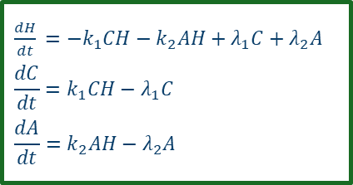
Behavioral model
$\frac{dH}{dt}$ $=−k_{1}CH−k_{2}AH+λ_{1}C+λ_{2}A$
$$\frac{dC}{dt}=k_{1}CH−λ_{1}C$$
$$\frac{dA}{dt}=k_{2}AH−λ_{2}A$$
$$B_{i}= \frac{k_{i}}{λ_{i}} with i=1,2.$$

Slide 14
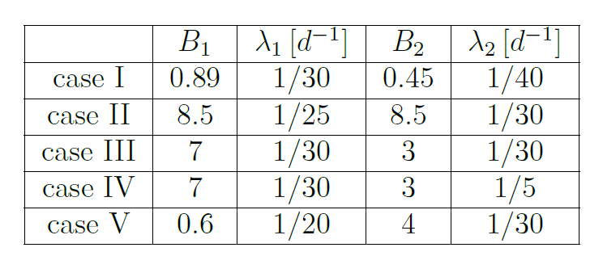
I case:
II case
Behavioral model
Nullclines plots
III case:
IV case:
V case:

Slide 15
Behavioral model
Heedless – Compliant – Against dynamic
I case:
II case:
III case:
IV case:

Slide 16
Behavioral model
Asymptotical value of Behavioral Compartments varying $B_{1}, B_{2}$:

Slide 17
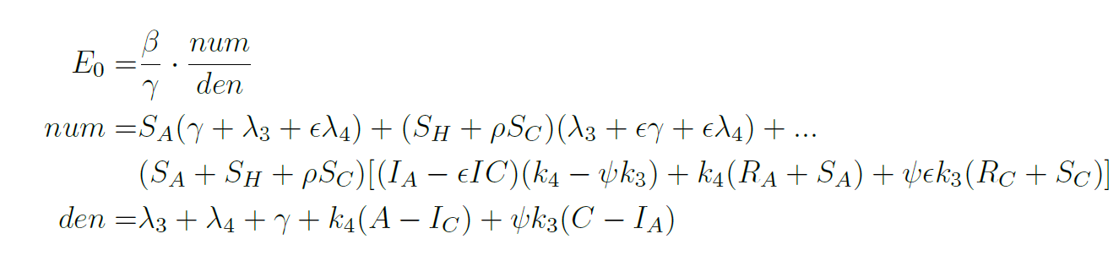
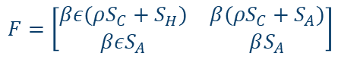
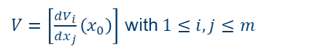
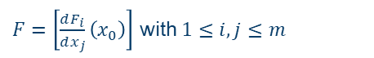
Epidemic- behavior Reproduction number $E_{0}$
Next generation matrix method
05
$F=\left[\frac{dF_{i}}{dx_{j}}\left(x_{0}\right)\right]$ with $1≤i, j≤m$
$$x={\left(x_{1},x_{2},…, x_{n}\right)}^{T}$$
$$E_{0}=spec\left(FV^{−1}\right)$$
$V=\left[\frac{dV_{i}}{dx_{j}}\left(x_{0}\right)\right]$ with $1≤i, j≤m$
$\frac{dx_{i}}{dt}=F_{i}\left(x\right)−V_{i}\left(x\right)$ for $i=1,2,…, m$
$$F=\left[\begin{matrix}βε(ρS_{C}+S_{H}) & β(ρS_{C}+S_{A}) \\ βεS_{A} & βS_{A}\end{matrix}\right]$$
$$V= \left[\begin{matrix}λ_{3}+k_{4}\left(S_{A}+I_{A}+R_{A}\right)+γ−ψk_{3}I_{A} & k_{4}I_{C}−λ_{4}−ψk_{3}(S_{C}+I_{C}+R_{C}) \\ ψk_{3}I_{A}−λ_{3}−k_{4}(S_{A}+I_{A}+R_{A}) & ψk_{3}\left(S_{C}+I_{C}+R_{C}\right)−k_{4}I_{C}+λ_{4}+γ\end{matrix}\right]$$

Slide 18
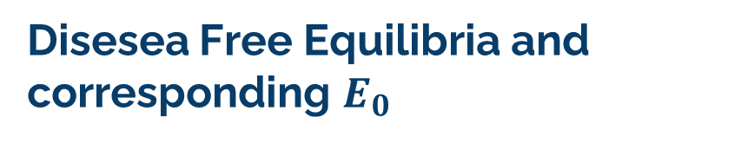
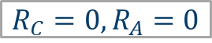
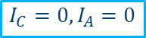
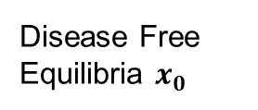
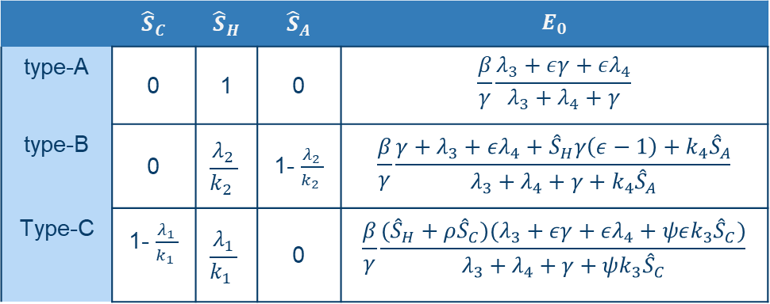
Disesea Free Equilibria and corresponding $E_{0}$
Disease Free Equilibria $x_{0}$
 | $${\hat{S}}_{C}$$ | $${\hat{S}}_{H}$$ | $${\hat{S}}_{A}$$ | $$E_{0}$$
type-A | 0 | 1 | 0 | $$\frac{β}{γ}\frac{λ_{3}+εγ+ελ_{4}}{λ_{3}+λ_{4}+γ}$$
type-B | 0 | $$\frac{λ_{2}}{k_{2} }$$ | 1- $\frac{λ_{2}}{k_{2} }$ | $$\frac{β}{γ}\frac{{γ+λ}_{3}+ελ_{4}+{\hat{S}}_{H}γ\left(ε−1\right)+k_{4}{\hat{S}}_{A}}{λ_{3}+λ_{4}+γ+k_{4}{\hat{S}}_{A}}$$
Type-C | 1- $\frac{λ_{1}}{k_{1} }$ | $$\frac{λ_{1}}{k_{1} }$$ | 0 | $$\frac{β}{γ}\frac{({\hat{S}}_{H}+ρ{\hat{S}}_{C})(λ_{3}+εγ+ελ_{4}+ψεk_{3}{\hat{S}}_{C})}{λ_{3}+λ_{4}+γ+ψk_{3}{\hat{S}}_{C}}$$
$$I_{C}=0, I_{A}=0$$
$$R_{C}=0, R_{A}=0$$

Slide 19
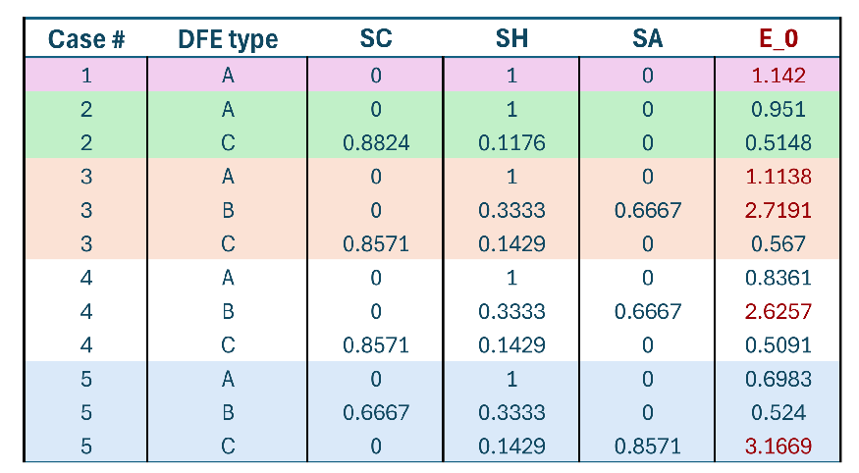
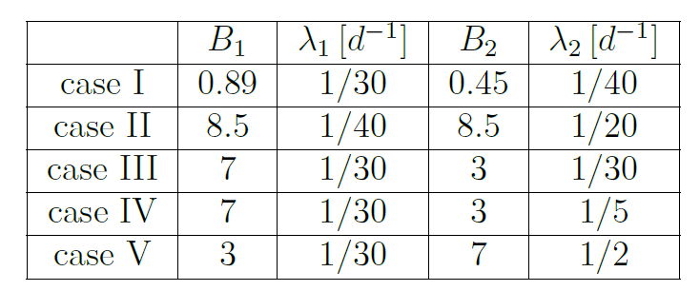




S$imulations$and ${ E}_{0}$ value
I case
II case
V case
III case
IV case

Slide 20
Possible epidemic models
Networked models
Multi-system Multi-layer models
Stochastic models
how the structure impacts the epidemic
spread
Agent based models
useful with a lower number of individuals
or with demographic variability

